Slide 1
Unsupervised Semantic Segmentation by Distilling Features Correspondences
Paper review
Gibeom Kim (UST)

Slide 2
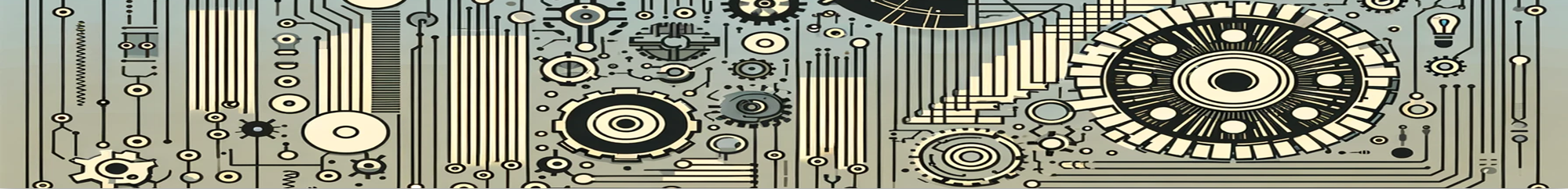
Index
Paper abstract
1-1. Optical flow
1-2. Correlation layer
1-3. correlation volume
Model
Conclusion

Slide 3
1. Paper abstract
Deep learning architecture for Unsupervised semantic segmentation
Extract feature from the images by using pretrained model, and transfer to segmentation head. Segmentation head
Also ambiguous set is clustered into two dataset.
During training, similar datasets are trained to produce similar outputs, while different snippets yield different outputs.

Slide 4
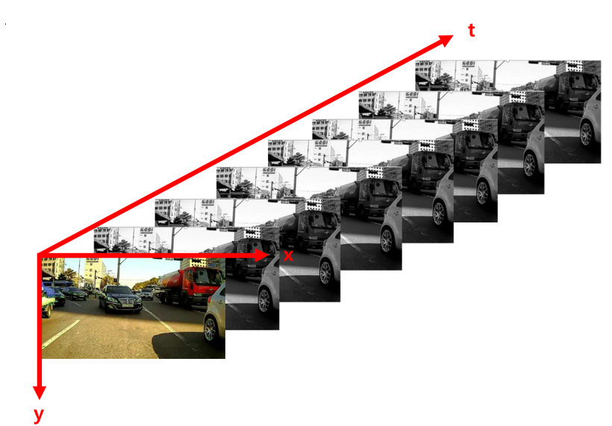
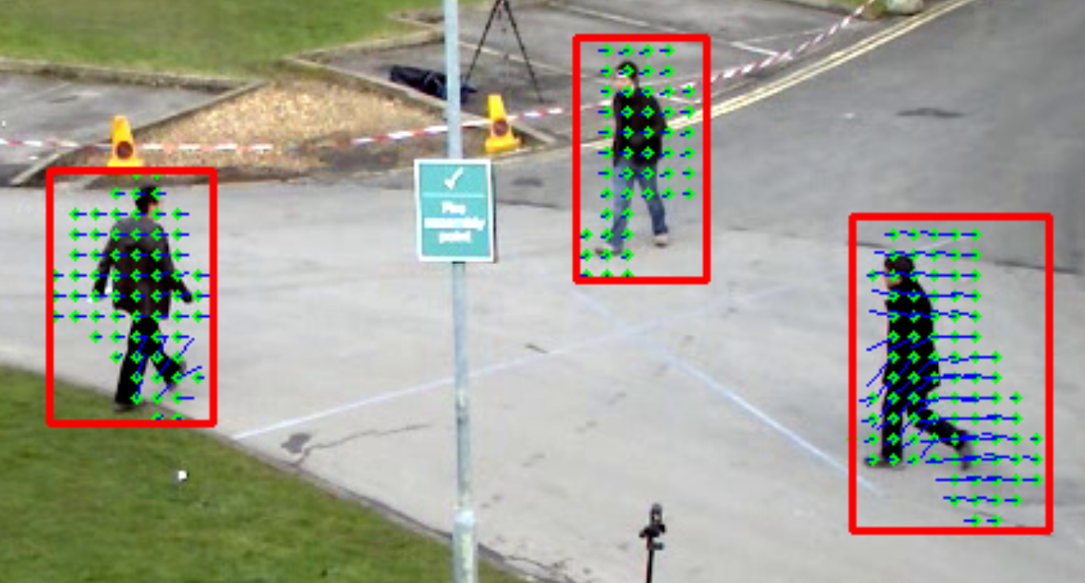
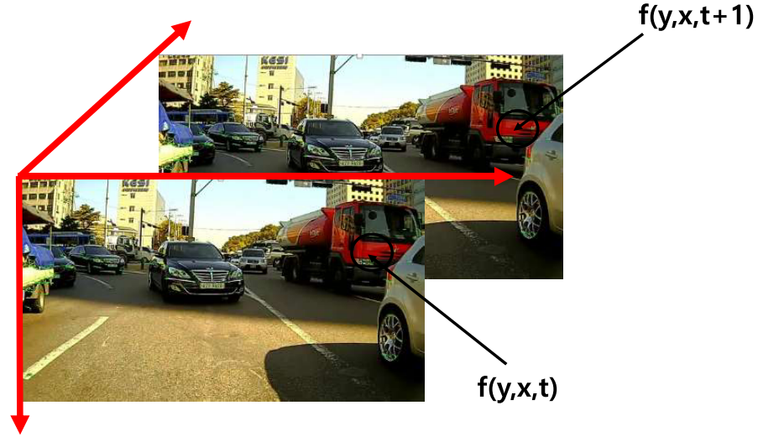
1-1. Optical flow

Slide 5
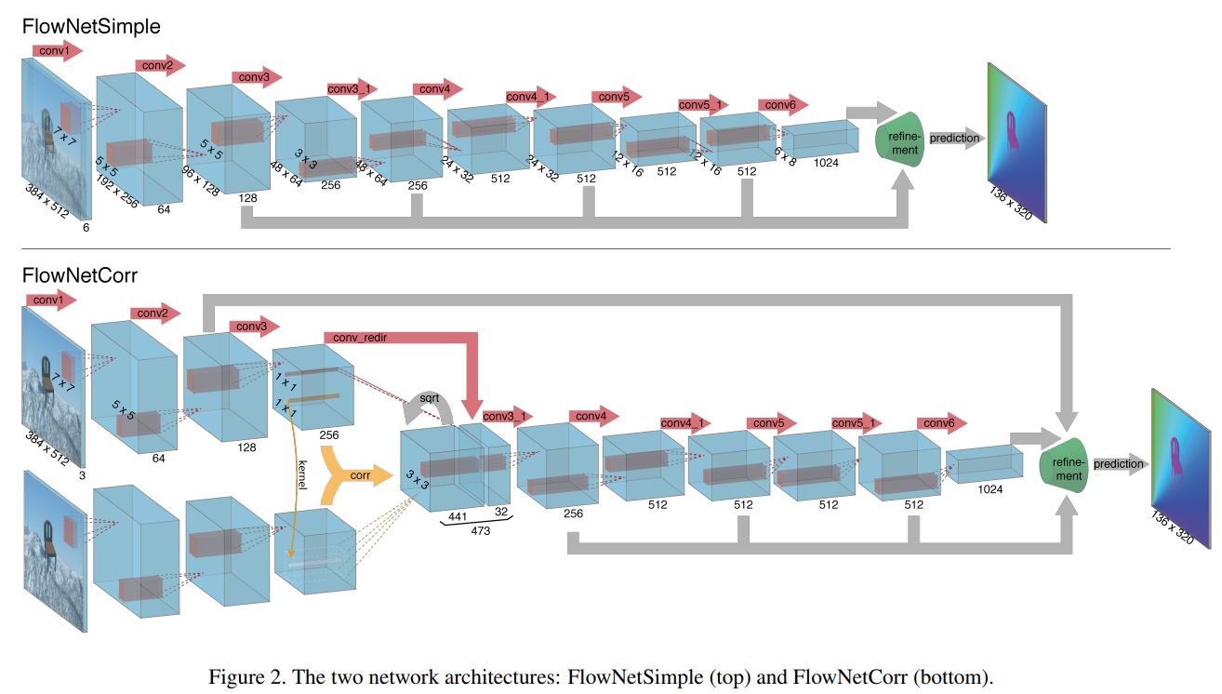
1-2. Correlation layer

Slide 6
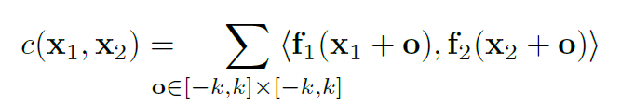
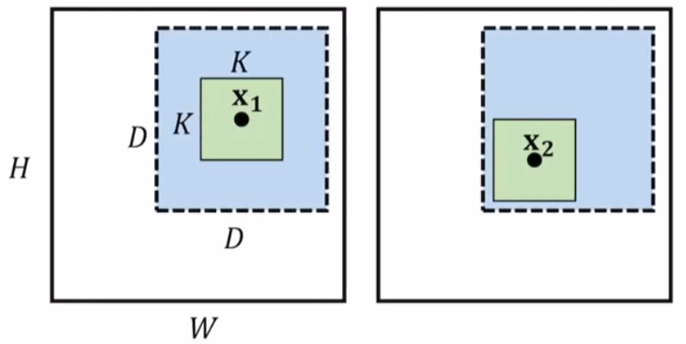
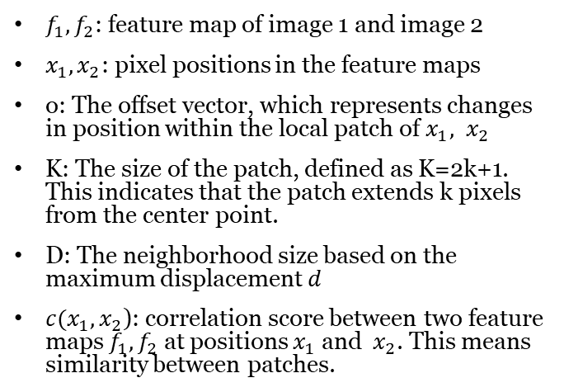
1-2. Correlation layer
$f_{1},f_{2}$: feature map of image 1 and image 2
$x_{1},x_{2}$: pixel positions in the feature maps
o: The offset vector, which represents changes in position within the local patch of $x_{1}, x_{2}$
K: The size of the patch, defined as K=2k+1. This indicates that the patch extends k pixels from the center point.
D: The neighborhood size based on the maximum displacement 𝑑
$c(x_{1},x_{2}$): correlation score between two feature maps $f_{1},f_{2}$ at positions $x_{1}$ and ​ $x_{2}$. This means similarity between patches.

Slide 7
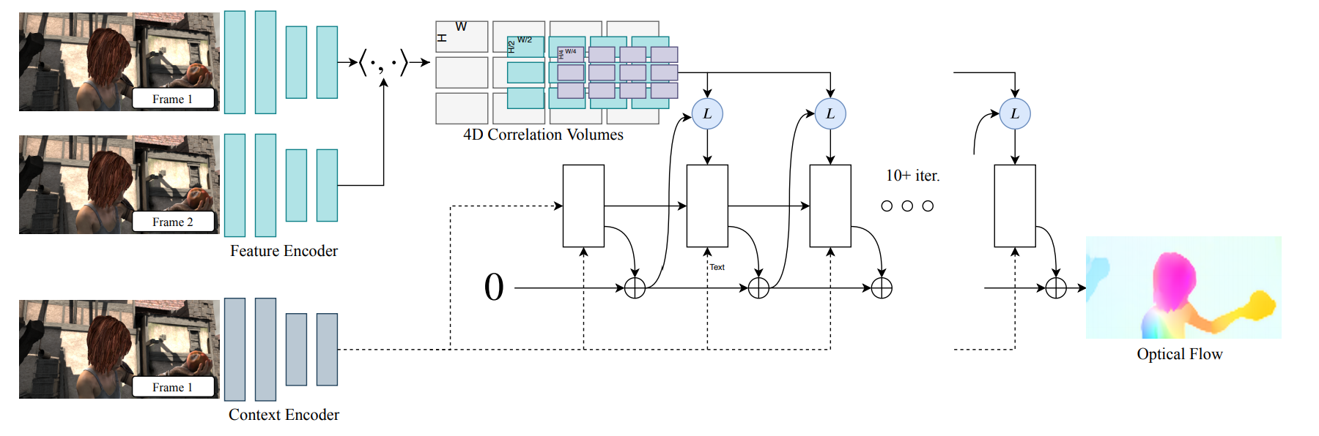
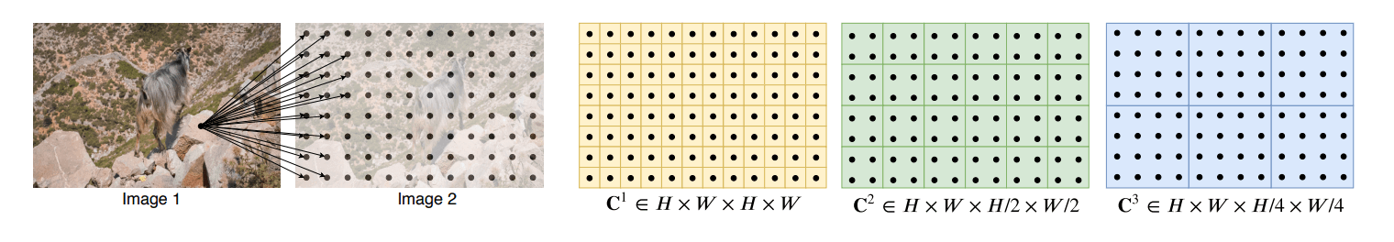
1-3. Correlation volume

Slide 8
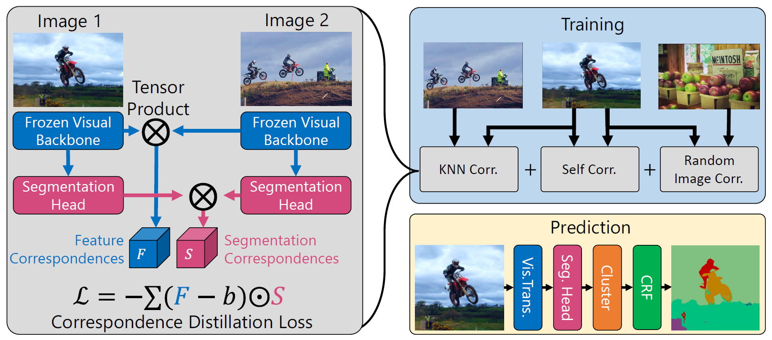
2. Model

Slide 9
2. Model

Slide 10
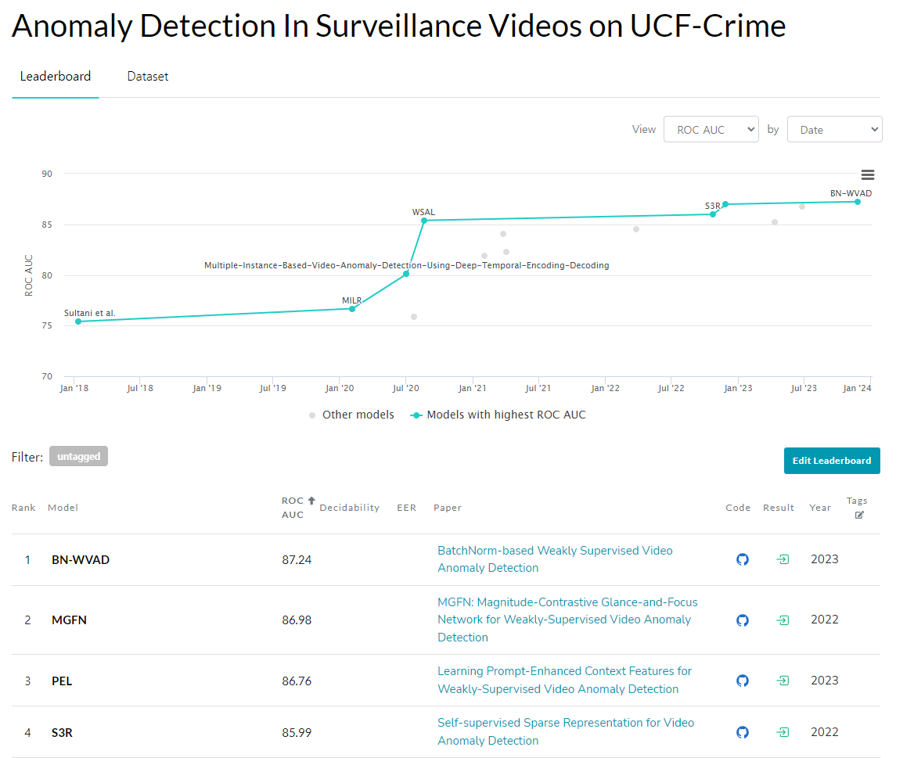
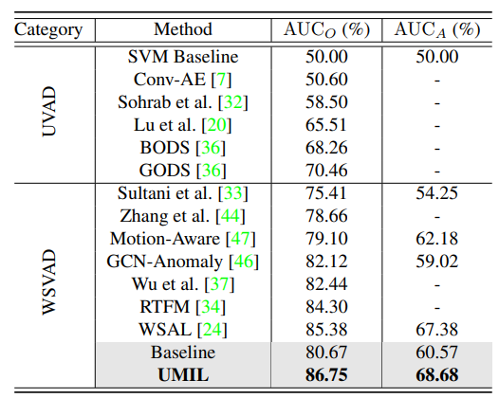
3. Conclusion

Slide 11
Thank you

